Slide 1
OOG
By: Preston Kruty, Christian Auman, Jessica Gyorki, John Shuble

Slide 2
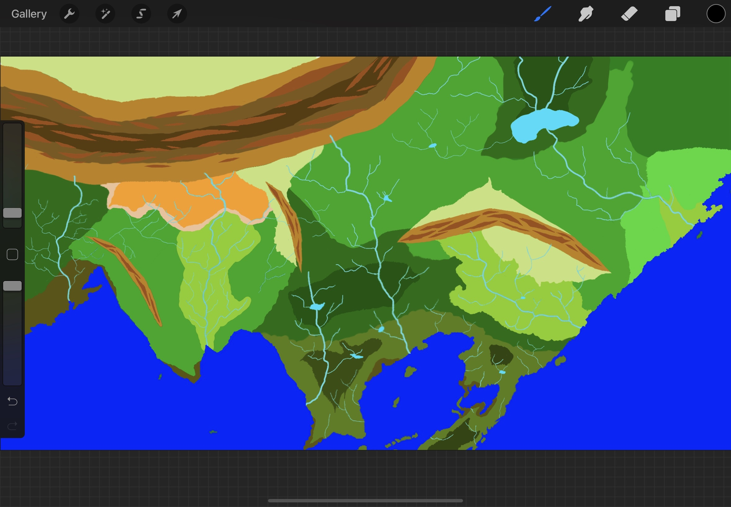
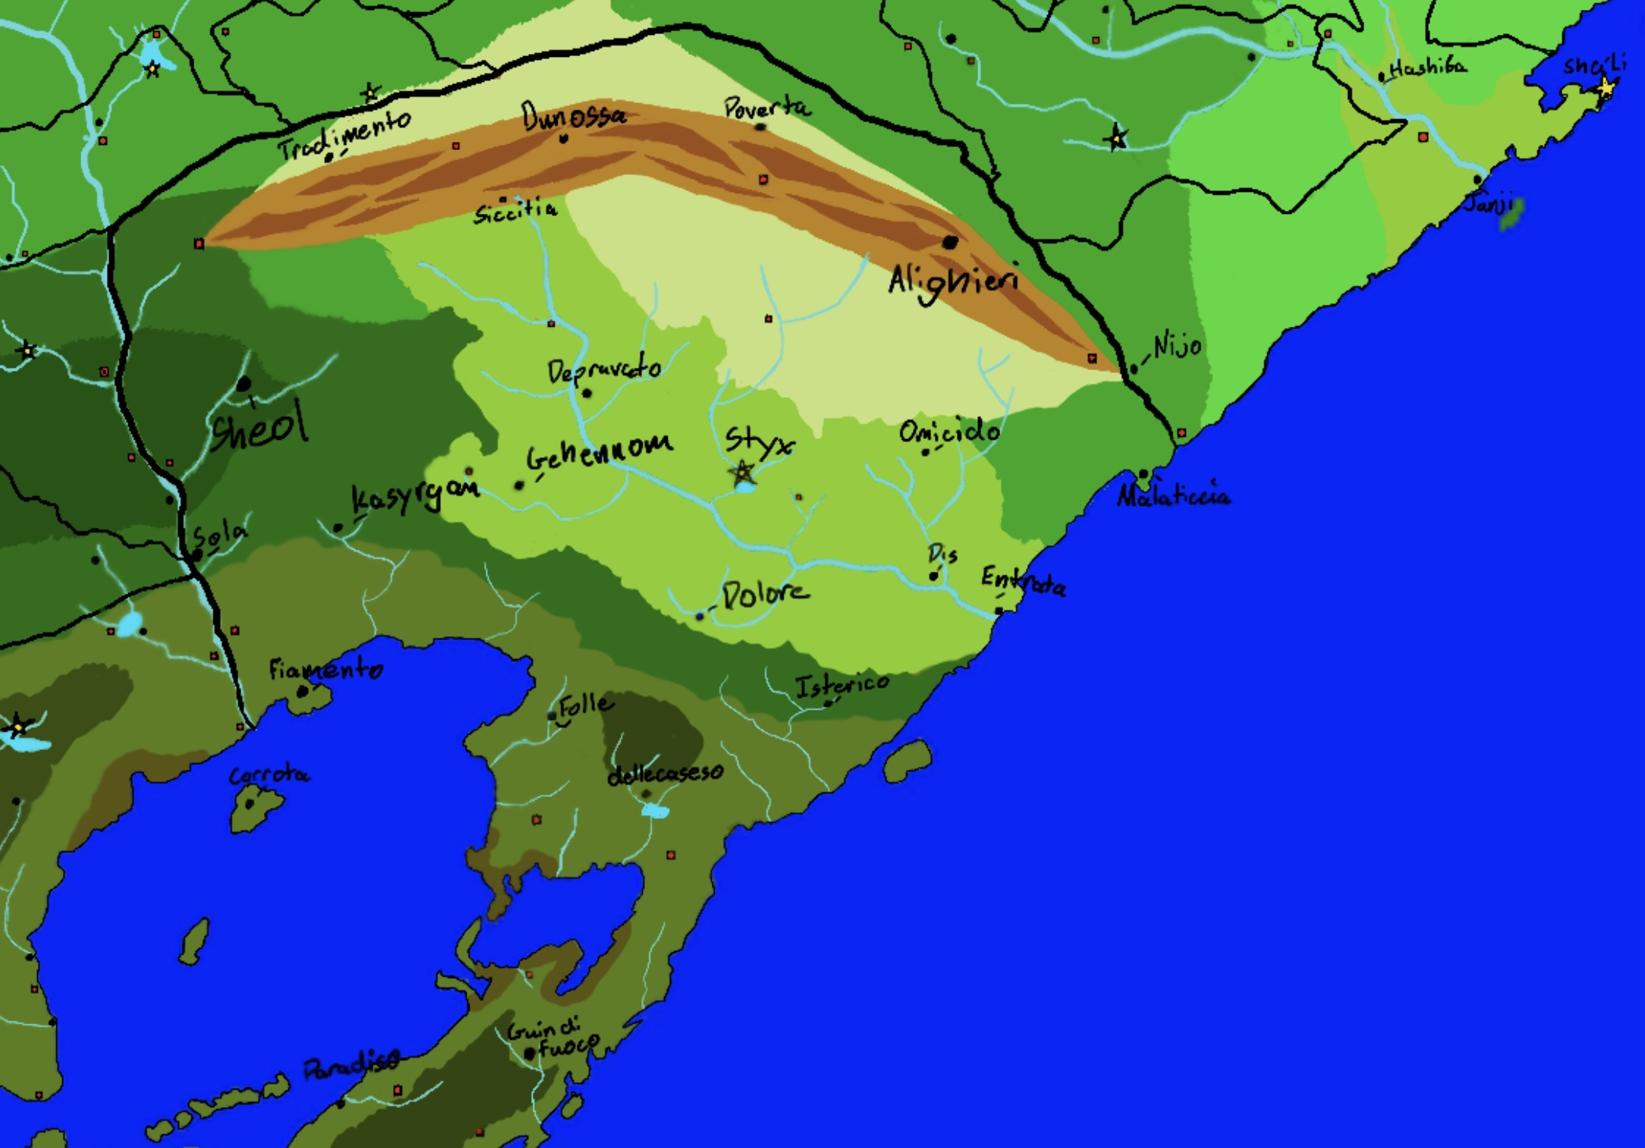
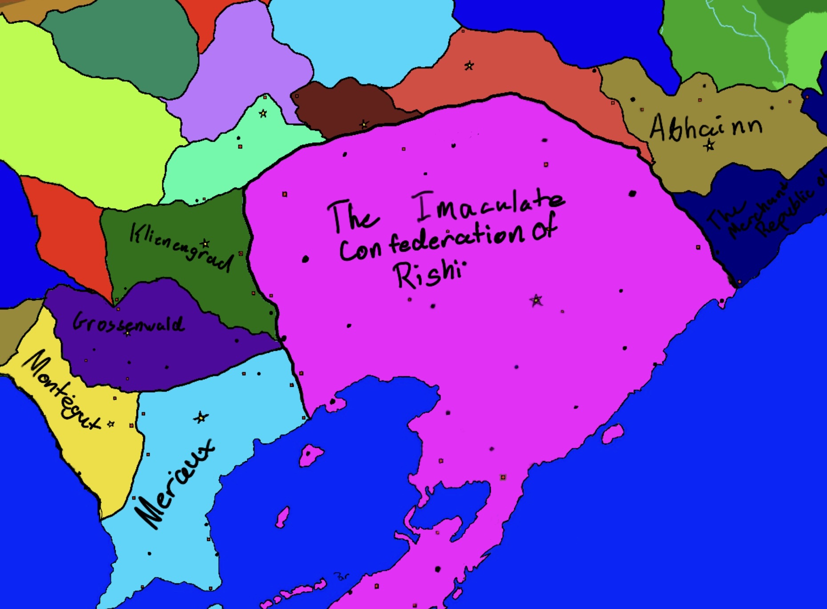
First game Idea

Slide 3
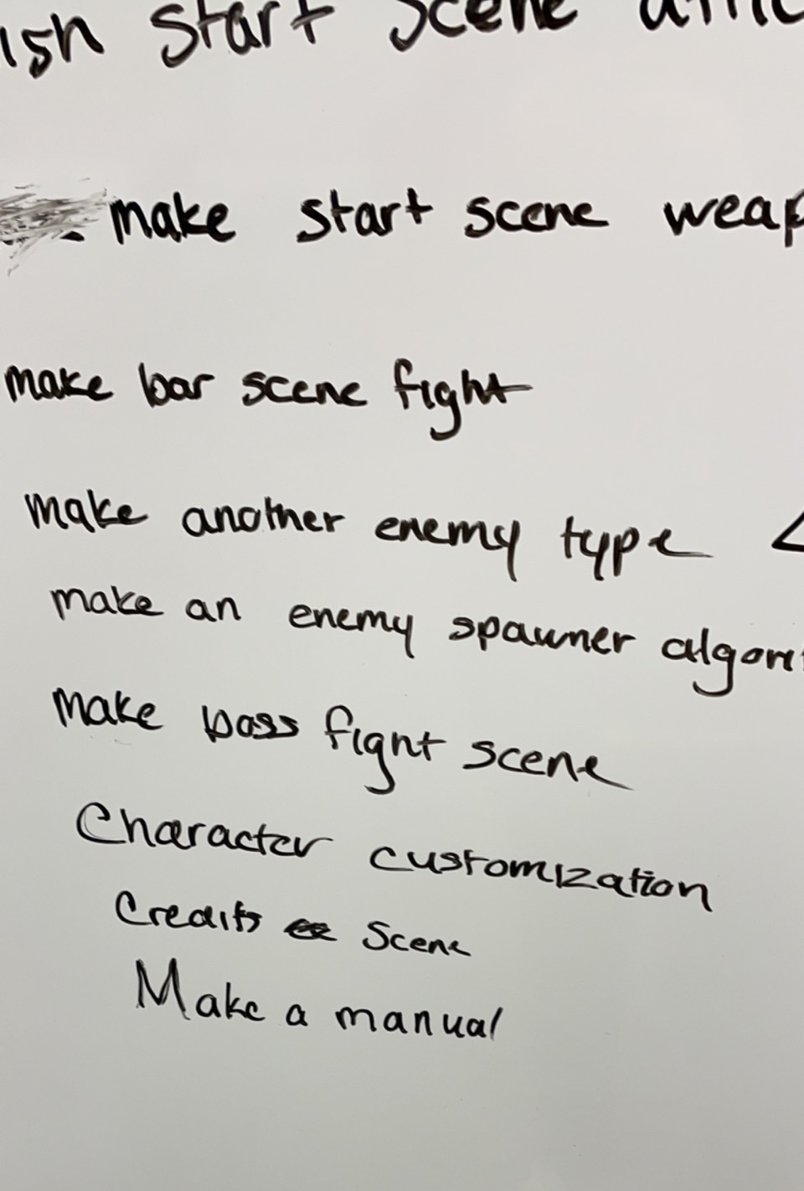
To-do board

Slide 4
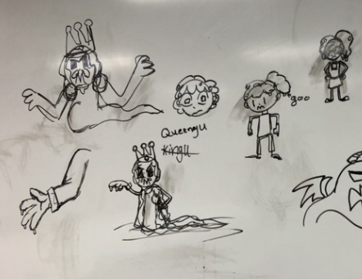
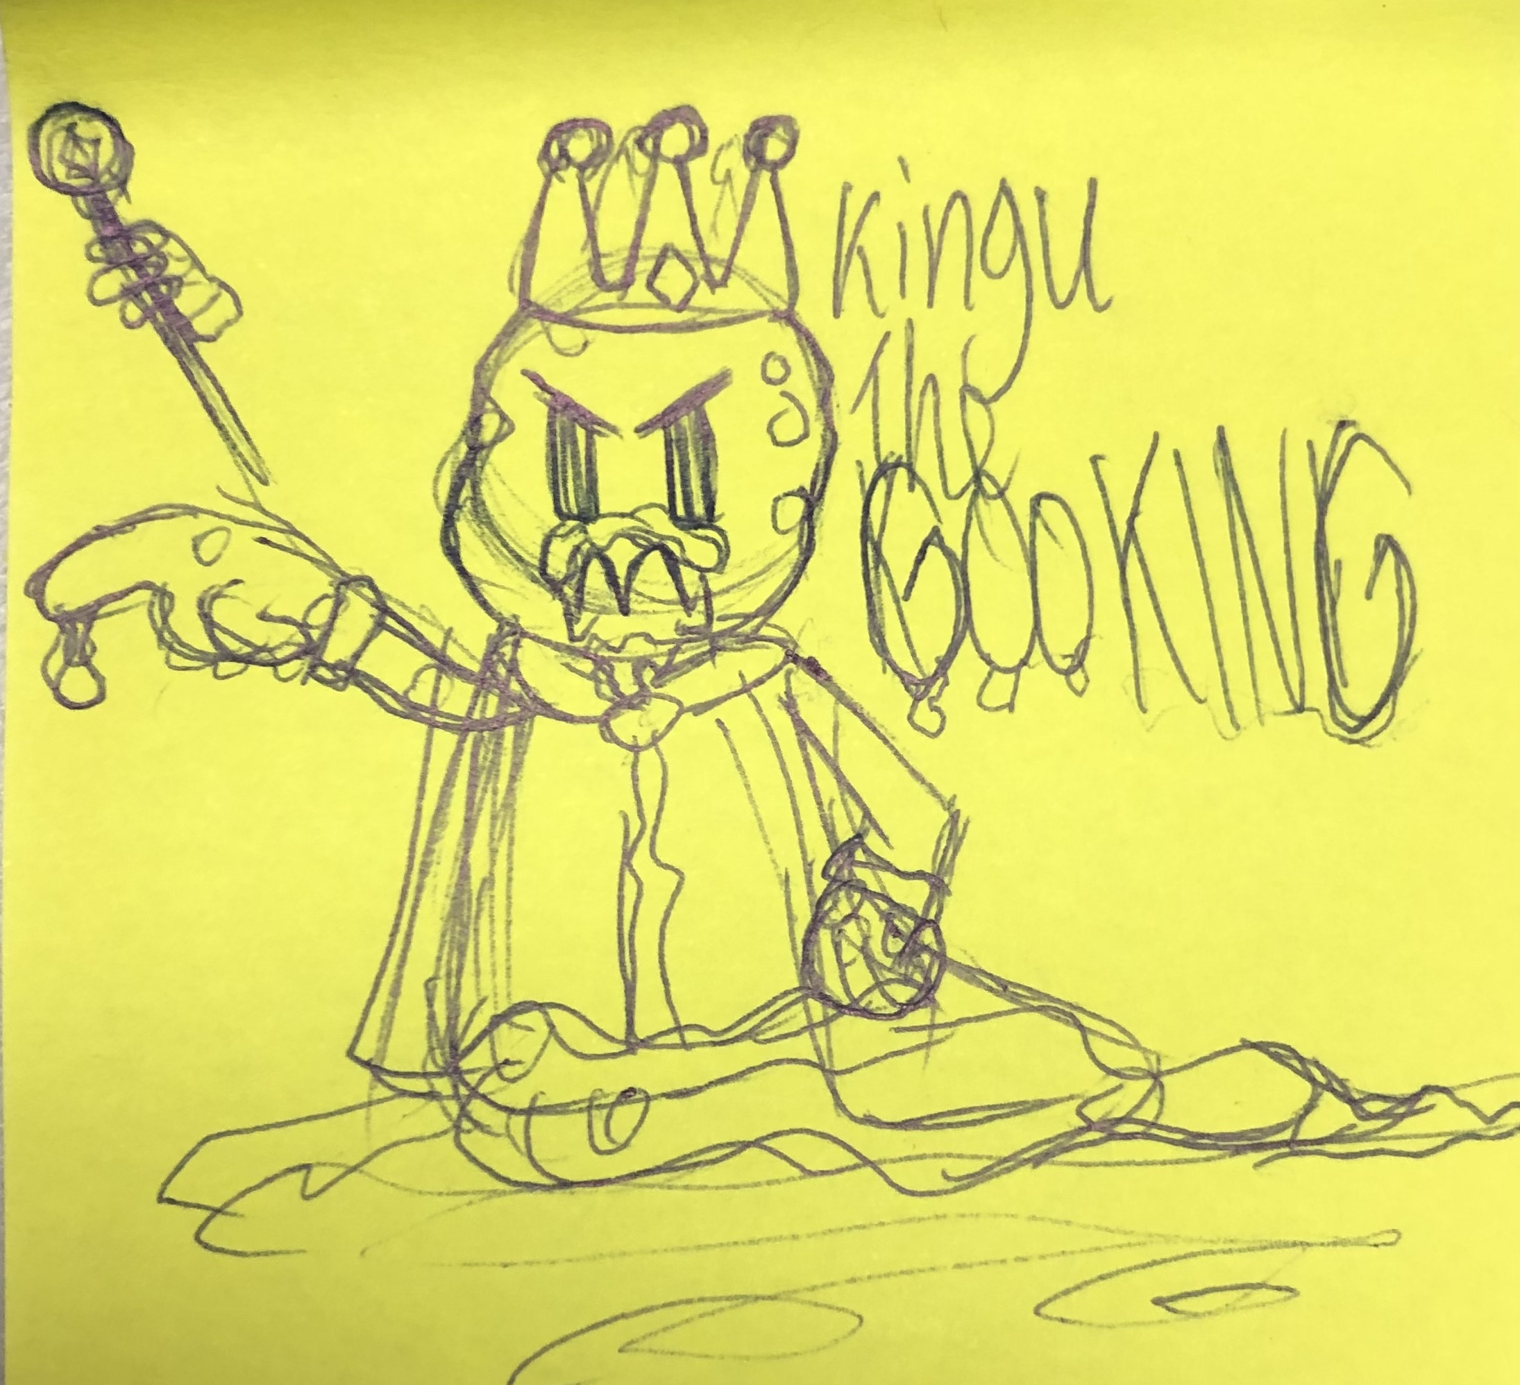
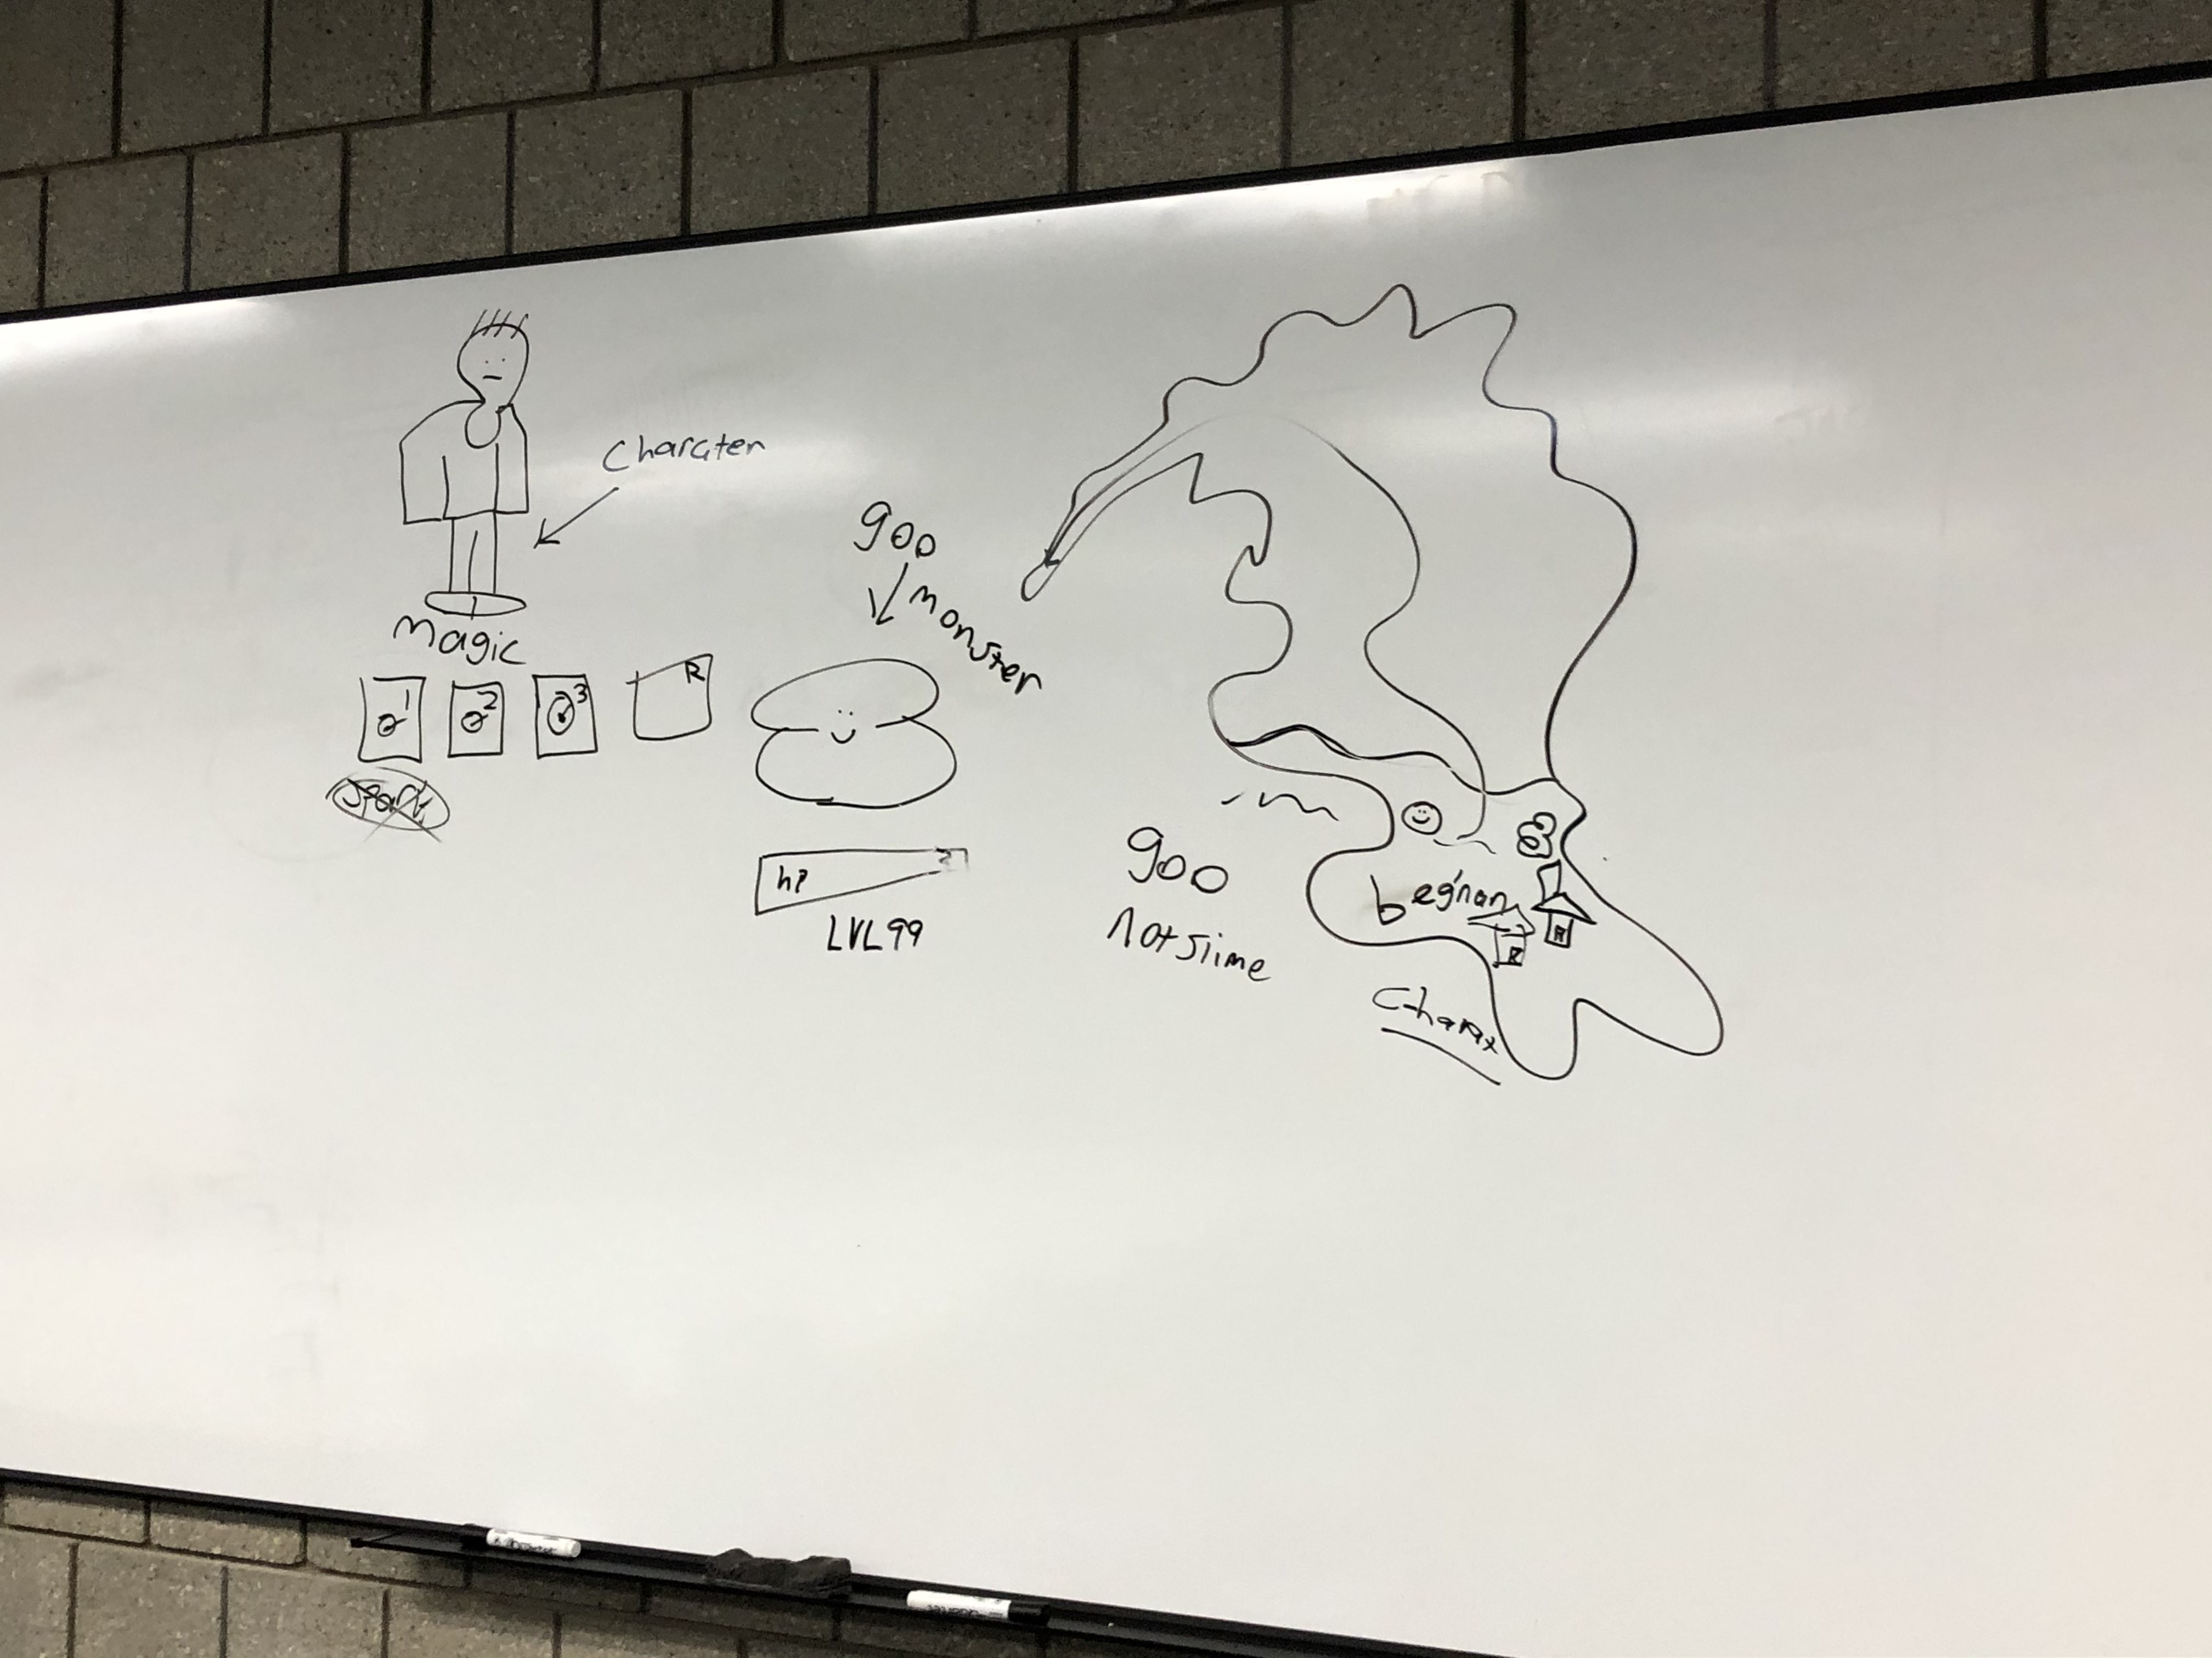
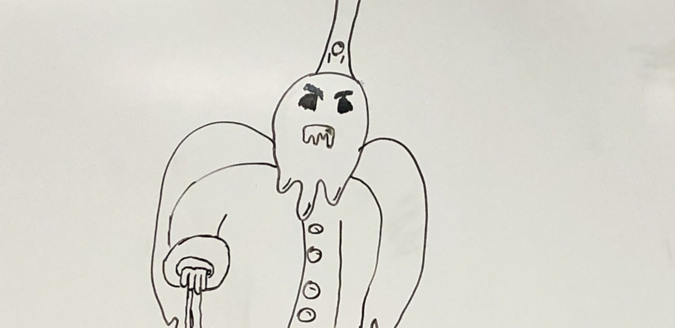
Concept ideas

Slide 5


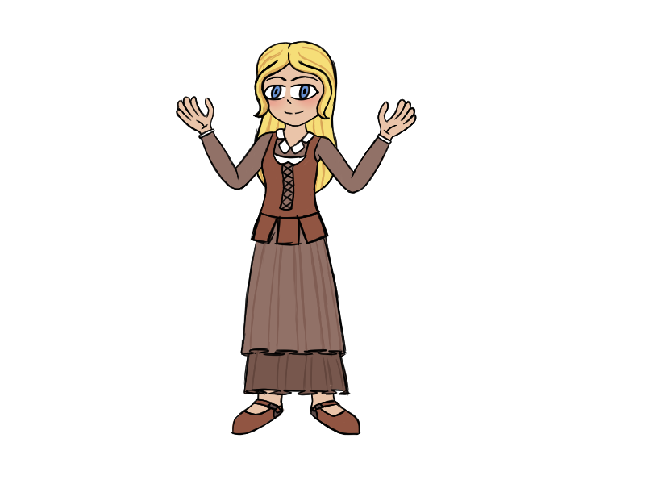
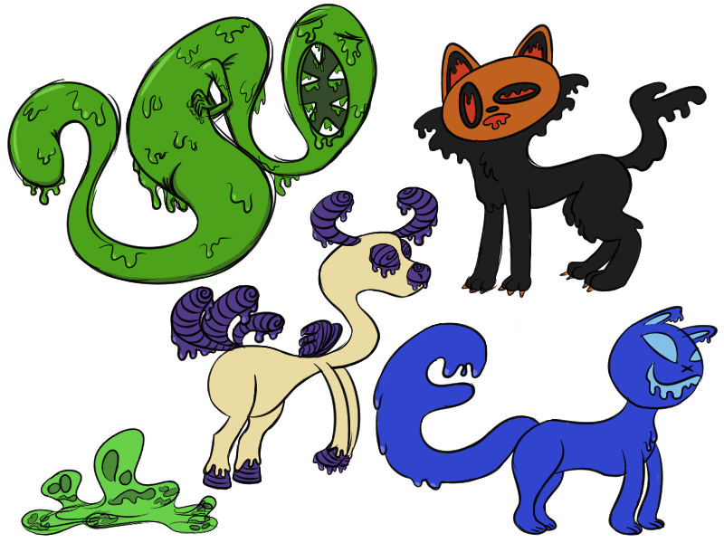
Concept art

Slide 6
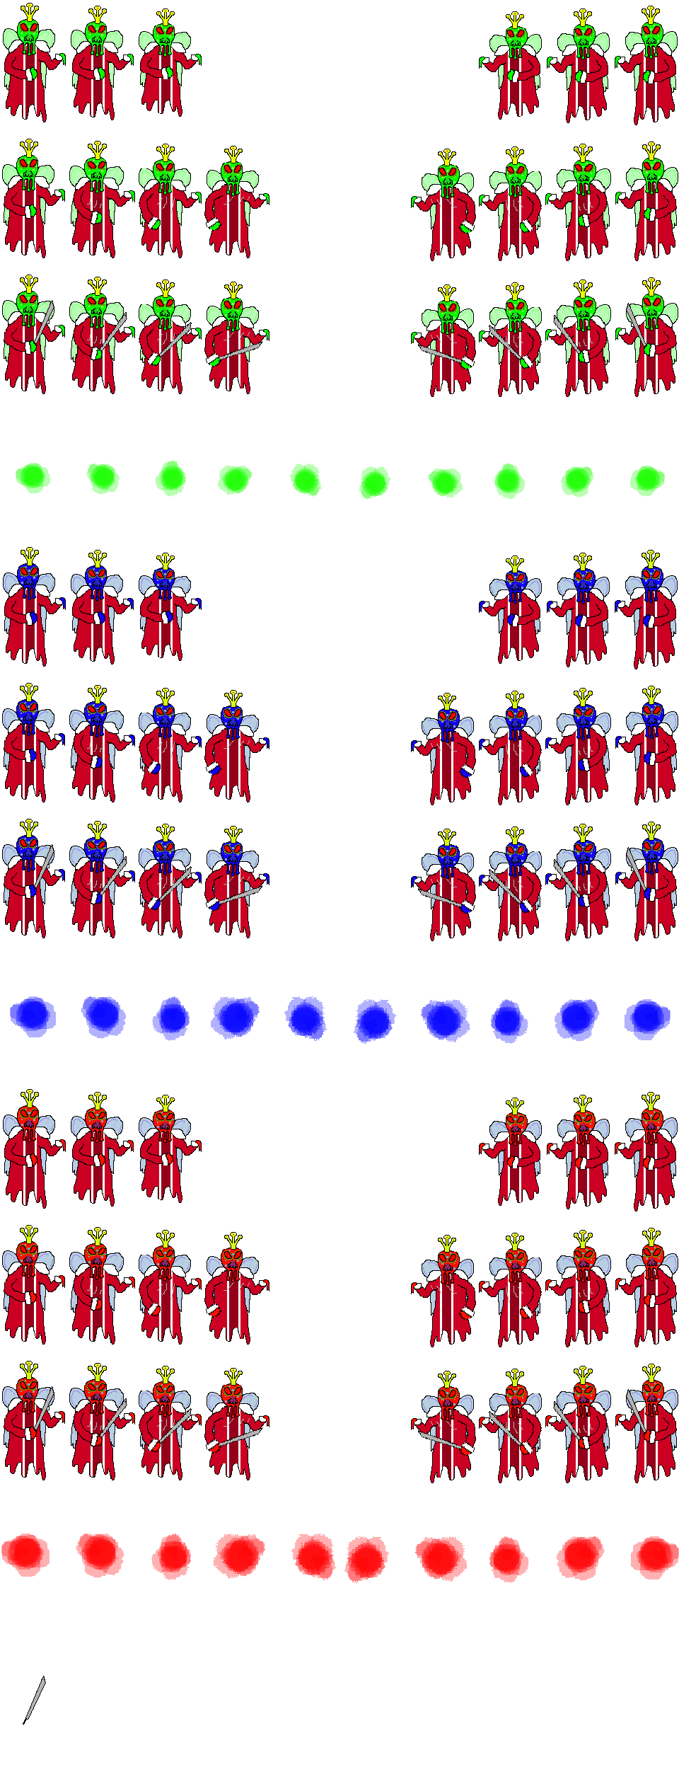

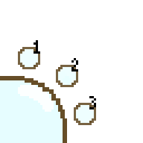

More Designs

Slide 8
New Input system
Had to learn the new input system from Unity and it took a very long time
Made game very smooth
Steep learning curve
It had to be in one class because otherwise if it was in multiple classes at once it be too many inputs at once
This system makes it more object oriented
This system allowed to go diagonally

Slide 9
Projectile development
Created a specific projectile class to handle the behavior for the projectiles such as the throwing axe and fire ball
The aforementioned input and the player class worked with the projectile class to make the combat functional

Slide 10
hot bar management development
At first we used the ‘1’ ‘2’ & ‘3’ keys for the hot bar input.
The mouse wheel was the second option, but it wasn’t very reliable and not player friendly as well as clunky.
We finally decided on using the ‘Q’ & ‘E’ keys for the final product because it was more efficient and player friendly.
We experienced a problem with creating a loop we then used an array to solve this problem.

Slide 11
Dynamic weapon design
We had trouble making a path for the curved fireball which we solved by creating a separate class for the whole object

Slide 12
Monster Design And Development

Slide 13
Boss System
Making boss sytem

Slide 14
Dynamic Boss Stages

Slide 15
Player UI
Nothing

Slide 16
Deriving inspiration from dnd to our combat system
Nothing

Slide 17
Dealing with bugs with the combat system
Nothing

Slide 18
Npc design

Slide 19
Design tie ins with the character design

Slide 20
Makin

Slide 21
World Building and Development

Slide 22
Character Design and Development

Slide 23
Dialog Design

Slide 24
UI Design

Slide 26
Idea graveyard

Slide 27
Character designs
Character Customization
Queen goo
(Second Boss)

